Slide 1
Chapter 1: Computer Systems
Levels of Abstraction
Hardware
Software
Database Systems
Notes:
Let’s get started with Chapter 1.
In this chapter we will cover Levels of Abstraction and apply it to Hardware, Software and Database Systems

Slide 2
CSC376 COMPUTER ORGANIZATION AND ARCHITECTURE
Course Outline
  First - general introduction to computer architecture, data representation, and the von Neumann computer model.
  Second – C++ high level programming ,Pep/8 system, assembly programming and how high-level language features map onto assembly language.
  Then – Combinational and Sequential Circuits
  Finally - Introductions to systems topics covered in later courses.
Notes:
This is how the course will progress:
First, we have a general introduction to computer architecture and data representation. We will also look at the von Newmann computer model.
Next, we will learn C++ and then assembly language for the Pep/8 simulator. We will see how a complier translates the high level language to assembly.
Then, we will learn how this is controls the electrical circuits at the core of a computer.
Finally, as time permits, we will introduce system topics covered in later courses.

Slide 3
ARCHITECTURE & ORGANIZATION
Architecture is those attributes visible to the programmer
  Instruction set,
  Number of bits used for data representation
  I/O mechanisms
  Addressing techniques.
  e.g. Is there a multiply instruction?
Organization is how features are implemented, typically hidden from the programmer
  Control signals
  Interfaces
  Memory technology.
  e.g. Is there a hardware multiply unit or is it done by repeated addition?
Notes:
*
There is a difference between “Organization” and “Architecture”.
As programmers, we use the Architecture of a system in our design of algorithms and the structure of our programs.
Computer organization refers to the low-level hardware we use to realize the architecture. It is often something we take for granted as programmers, however it can cause problems in execution that are hard to trace.
One way of thinking about it is that Architecture is a blueprint or recipe – The design.
Organization is the physical result of implementing the design.

Slide 4
ARCHITECTURE VS. ORGANIZATION
All Intel x86 family share the same basic architecture
The IBM System/370 family share the same basic architecture
This gives code Backwards compatibility
  i.e. older programs run on new processors
Each generation increased in complexity
  May be more efficient to start over with a new technology, e.g. RISC vs. CISC
Organization is what differs between different versions
Notes:
*
Hardware “Families” have the same architectures. These architectures can differ greatly between products:
ie, an Xbox 360 is very different internally from a Playstation 2/3 or a Nintendo (this is why you have to have the correct version of a game for your system instead of just having a single disk capable of playing on all platforms). However, there is a pragmatic reason for companies to develop an architecture and stay with it: application compatibility. No business or consumer wants to be forced to buy new applications every time the hardware changes. This is called backwards compatibility – ie, an older program often runs on a newer version of Windows as long as the version jump is not too large. The same is true of processors. Older operating systems and programs will run on newer processors. However, often programs will be rewritten to take advantage of the new features of a processor to gain speed and capability. My background is CAD – Computer Aided Design. That and video games have high demands for processing speed to handle the graphics. These programs often limit their backwards compatibility to take advantage of the new features in processors and operating systems.

Slide 5
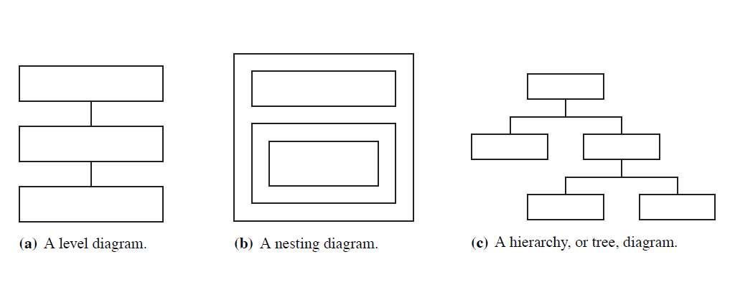
ABSTRACTION
Suppression of detail to show the essence of the matter
An outline structure
Division of responsibility through a chain of command
Subdivision of a system into smaller subsystems
Notes:
Several abstractions will be used to help you under stand the concepts presented. These remove the detail to give you a simple visual picture to help you grasp the essence of the topic
It can be in several forms as shown below. Trees are particularly important to many computer science topics. Please review the presentation on trees in the Worked Examples Section.

Slide 6
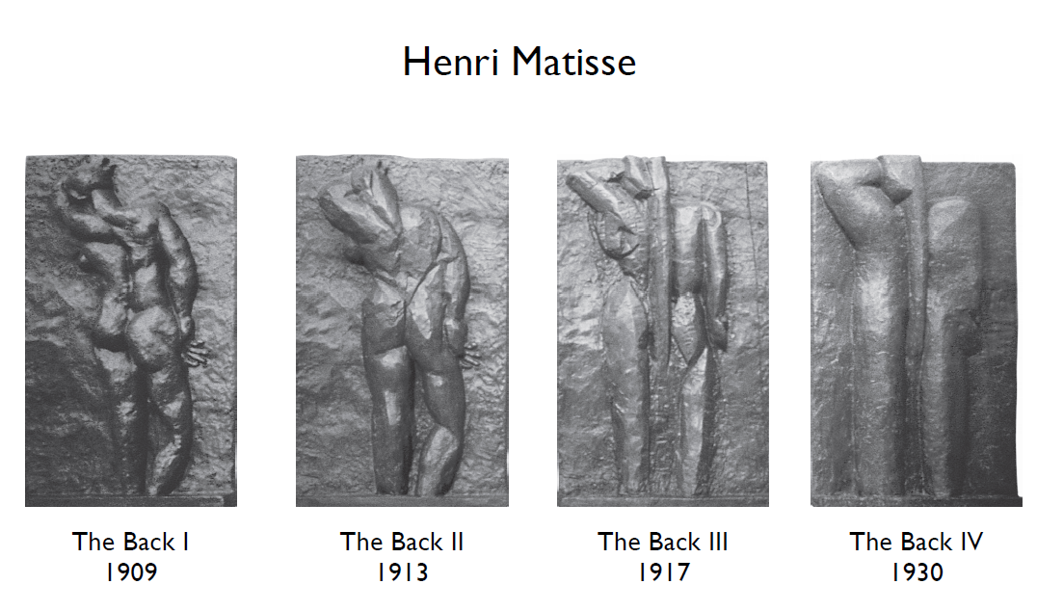
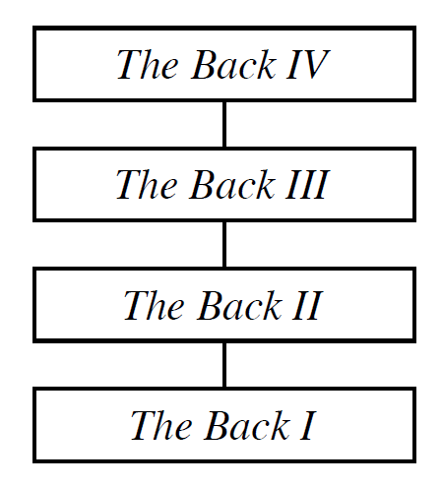
ABSTRACTION EXAMPLE
Notes:
This is an excellent example of abstraction in art that demonstrates the concept of abstraction itself. Matisse, a great artist, changed his style though the years and became more and more abstract. This shows how even with the simplification in “The Back IV,” the essence of the back is still captured. This course will be teaching you that essence of Computer Systems by using simplifications and not going into the details. This will allow you to develop an understanding of the various aspects without diving into the details.

Slide 7
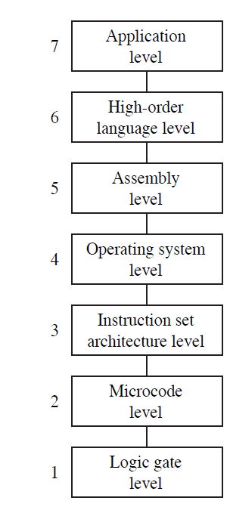
ABSTRACTION IN COMPUTER SYSTEMS
Language dependent on application program
Machine-independent programming language
Assembly language
Operating System Calls
Machine language
Microinstructions and register transfer
Boolean algebra and truth tables
Notes:
Here are the 7 levels of abstraction that the text will use though out the course to help you understand where each topic fits into the picture.
We assume that you have a background at level 7, so we will be starting at Level 6 and working down to Level 1.
Let’s look at each level a little closer.

Slide 8
THE MULTI-LEVEL MACHINE IDEA
  Level 7: Applications, e.g., Word, Excel, Video Games, Database Systems
  Level 6: High-level language, e.g., C, Java, which a compiler translates to assembly language
  Level 5: Assembly language (symbolic) translated by assembler into numeric form
  Level 4: Operating system. Some instructions in the output from the assembler are processed directly by level 3, others require action by the operating system. The Operating System itself is held in the form of machine code instructions.
  Level 3: “Machine Code” – binary instructions
  Level 2: Microinstuctions - Very simple program that interprets the machine code program.
  Level 1: Circuits are activated according to the current microinstruction. This is where, finally, computation actually happens.
Notes:
Level 7: Applications, e.g., Word, Excel, computer games written in high-level language.
This is where most users interact with a computer
Level 6: High-level languages, like C & Java, which a compiler translates to assembly language.
This is where most computer programmers operate.
Level 5: Assembly language (symbolic language) translated by assembler into numeric form.
This is used by embedded processor programmers for product specific control boards. The Power point on Motivation to study Assembly gives several examples on why programmers may need to code directly in The assembly language for the processor that they are using.
Level 4: Operating systems.
Windows, Linux, Unix are common operating systems in use today with various versions. MS-DOS is an older one that I used prior to Windows. Some instructions in the output from the assembler are processed directly by level 3, others require action by the operating system. The Operating System itself is held in the form of machine code instructions.
Level 3: “Machine Code”
These are the binary instructions that are actually loaded into the microprocessor.
Level 2: Microinstructions
A program of very simple microinstructions interprets the machine code program within the microprocessor.
Level 1: Circuits
Finally at Level 1 – Electrical circuits are activated according to the current microinstruction. This is where the computation actually happens.

Slide 9
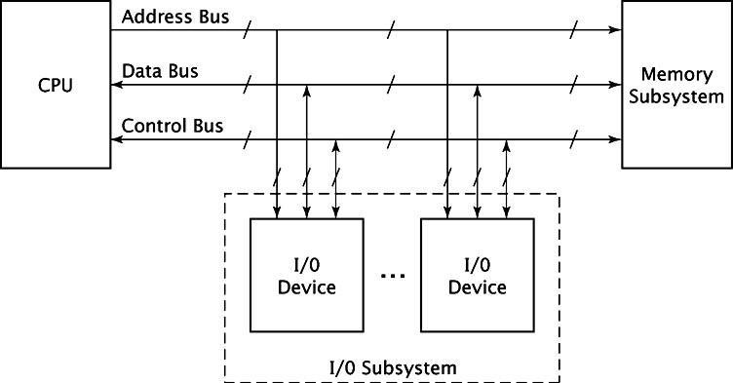
Computer System Structure
The overall system structure can be shown in the following diagram:
Notes:
We will also use an abstraction to show how the components are connected and how the information flows between them.
This shows four hardware components connected by three busses. Getting the information to flow between the devices is critical for the proper operation of the Computer System.

Slide 10
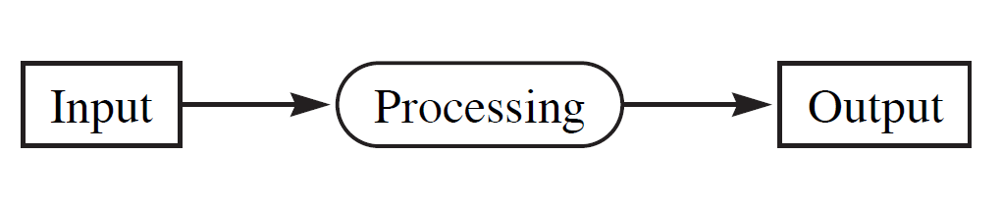
HARDWARE
The overall function of a computer system can be summed up with three activities:
Notes:
This abstraction will be used repeatedly.
A Computer System is a set of interrelated components working co-operatively to take input, process it and produce output.
This is true if you are playing a video game and press a button to make something happen on the screen.
Or – modeling a plastic part and put a hole in it
Or – if you press the print icon with your mouse and expect the printer to print.
All are inputs that the computer processes and produces an output – Hopefully the desired one!

Slide 11
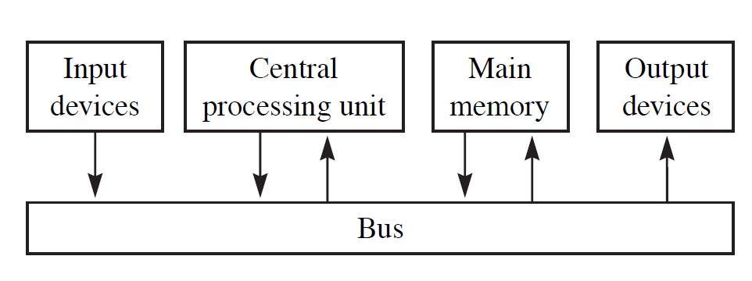
BASIC HARDWARE COMPONENTS
Every computer system has four basic hardware components:
Notes:
Now back to the hardware in a Computer System
Every computer system has four basic hardware components:
Input devices, CPU or Central Processing Unit, Main Memory, and Output devices.
All are tied together by a bus – actually several busses – but here is the abstraction again.
When everything is working – the information flows to and from the devices and the desired output is obtained.

Slide 12
BASIC HARDWARE
  Central Processing Unit (CPU)
    Where instructions are fetched and executed
  Memory system
    Where programs and data are stored on the main computer board
  Input/Output (I/O) system
    Responsible for input and output data to and from the memory system.
Notes:
Here are the three basic hardware components:
The Central Processing Unit (CPU) is where instructions are fetched and executed
The Memory system is where programs and data are stored on the main computer board. On PCs this is usually on the Mother Board
Input/Output (I/O) system which is responsible for input and output data to and from the memory system. There are a variety of these for all types of use.

Slide 13
INPUT DEVICES
Keyboards
Disk drives
USB Flash drives
Solid State drives
Magnetic tape drives
Mouse devices
Touchpads or Touchscreens
Bar code readers
Notes:
Here is a list of Input devices that most of you are familiar with and most likely interact with daily.
I am very pleased that my new computer has a solid state drive. It is screaming fast.
Magnetic tape drives were common as back up systems in the past, however they are becoming obsolete because of new technology that is cheaper and has much faster access times.

Slide 14
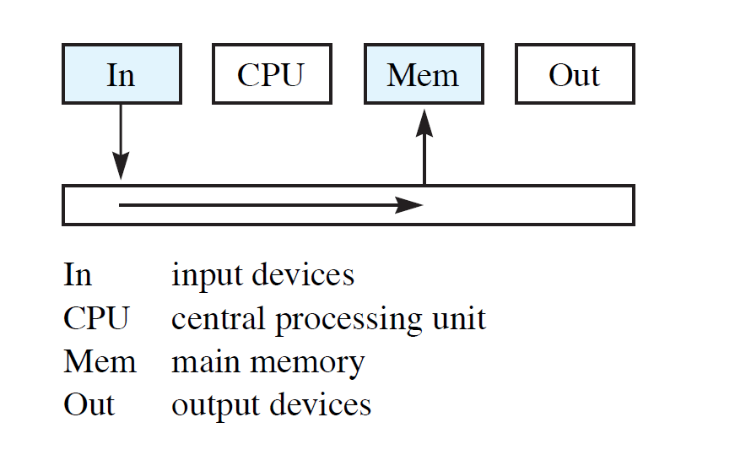
INPUT DEVICE DATA PATH EXAMPLE
Notes:
Here is an abstraction that shows that the information from the input device is typically passed to the bus and then to Memory.

Slide 15
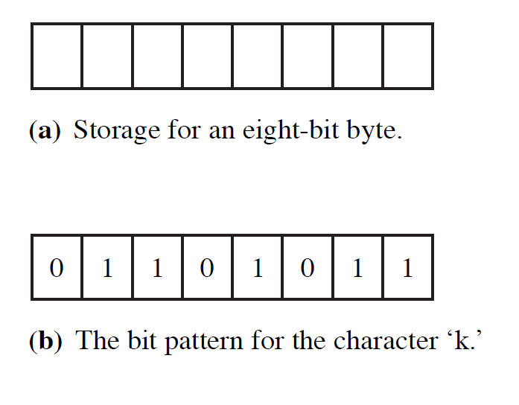
HARDWARE LEVEL STORAGE
At the lowest level, information is stored sequentially in Binary.
  Each individual 0 or 1 is a binary digit: Bit
  Eight bits is called a Byte
What is the name of the common binary code that represents alphabetic characters?
Notes:
Information is stored in memory in binary form.
Bits and bytes.
Do you know what is the name for the common binary code that represents English alphabetic characters in a computer?
It is ASCII - American Standard Code for Information Interchange. It was first used in the 1960s and U.S. President Lyndon B. Johnson mandated that all computers purchased by the United States federal government support ASCII on and after July 1, 1969,

Slide 16
OUTPUT DEVICES
Disk drives
USB Flash drives
Solid State drives
Magnetic tape drives
Screens
Printers
Sound Speakers
Notes:
Here is a list of Output devices that most of you are familiar with and interact with daily (or even hourly)
And though I was around before cell phones, I keep my iPhone near me all day long.

Slide 17
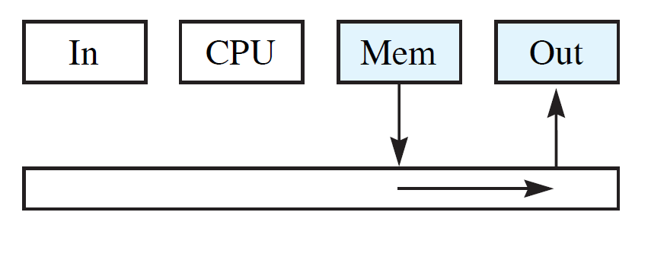
OUTPUT DEVICE DATA PATH EXAMPLE
Data flows from main memory onto the bus to the output device.
Notes:
And here we see, similar to the input devices, the information is typically passed from memory to the bus and then to the output device.

Slide 18
I/O SUBSYSTEM
A computer communicates with the outside world through its input/output (I/O) subsystem.
I/O devices connect to the CPU through various interfaces.
I/O can be memory-mapped-- where the I/O device behaves like main memory from the CPU’s point of view.
I/O can be instruction-based, where the CPU has a specialized I/O instruction set.
Notes:
The I/O devices are very important. That is how the Computer System communicates with the world.
Here we see that there are different ways for the I/O devices are connected to the CPU various ways
Though special interfaces
It can be memory mapped
Or the CPU can have a specialized I/O instruction set – this would increase the speed of I/O handling

Slide 19
MAIN MEMORY
Main memory is volatile storage
  Holds data and instructions for the CPU
  RAM (random access memory)
A memory system can be viewed as an array of memory locations each of which can store multiple-bit binary data
Memory locations are selected by addresses for either read or write operations
Notes:
Main memory is volatile storage
volatile means that when the power is removed it looses its information
It holds data and instructions for the CPU
It is called RAM (random access memory)
This means that it doesn’t need to be read sequentially
A memory system can be viewed as an array of memory locations each of which can store multiple-bit binary data
Memory locations are selected by addresses for either read or write operations

Slide 20
MEMORY ORGANIZATION
Memory Types:
  Read-Only Memory (ROM):
    Masked ROM is manufactured with data inside; does not change.
    Programmable ROM (PROM) program-once devices.
    Erasable PROM (EPROM): erased by holding the chip's "window" under ultraviolet light.
    Electrically erasable PROM (EEPROM): erased by the programming device; portions can be selectively erased.
    Flash EEPROM is erasable in blocks (good for digital cameras).
  Random Access Memory (RAM):
    Dynamic RAM (DRAM): constructed from leaky capacitors and requires periodic recharge.
    Static RAM (SRAM): does not need refreshing; more expensive.
Notes:
There are several types of memory that are used in computer systems:
Read-Only Memory (ROM):
Masked ROM is manufactured with data inside; does not change. This is used for products that are produced in the millions and the program is put in the processor by the chip manufacture. It is cheaper to produce this way but it does not allow the program to change.
Programmable ROM (PROM) program-once devices. This is used for products that are mass produced but in lower quantities. However, this allows the manufacturer to program the product on the assembly line and it allows updates to the program for newly produced products.
Erasable PROM (EPROM): erased by holding the chip's "window" under ultraviolet light. This is commonly used by software developers for testing.
Electrically erasable PROM (EEPROM): erased by the programming device; portions can be selectively erased. This is becoming very popular as it allows the program to be upgraded in the field like the BIOS in your computer.
Flash EEPROM is erasable in blocks Similar to the one above it is common on digital cameras.
Random Access Memory (RAM):
Dynamic RAM (DRAM): constructed from leaky capacitors and requires periodic recharge.
Static RAM (SRAM): does not need refreshing; more expensive

Slide 21
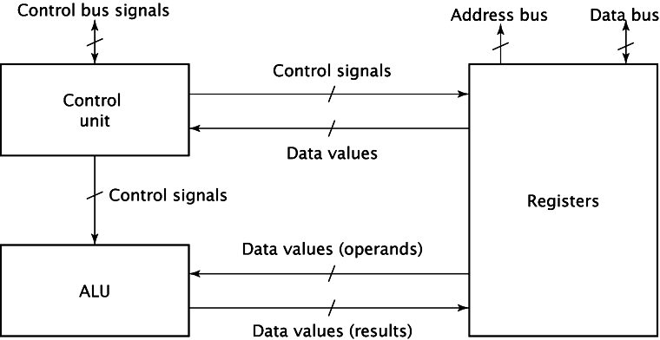
CPU ORGANIZATION
Three basic components within the CPU:
1) Registers
2) Control unit
3) ALU
Notes:
Here is an abstraction of a CPU
Registers are used to store data in the CPU.
Some are general purpose, some have specific purposes.
E.g., during fetch CPU places contents of program counter (PC) register on address bus then stores fetched instruction in instruction register (IR).
Control unit controls operation of the other CPU components.
Asserts information on the control lines (READ, WRITE, IO/M) which causes registers to load data, clear contents, output contents, etc.
ALU (arithmetic/logic unit) implements arithmetic and logic instructions.

Slide 22
SYSTEM BUSES
The four major components are connected by buses
  Address bus
  Data bus
  Control bus
Notes:
Here an abstraction is used to show how the components are connected and how the information flows between them.
This shows four hardware components connected by three busses.
The Address bus which provides the address for the memory location to be addressed for input & output
The Data bus which transfers data from CPU or I/O to the memory and from the memory to the CPU or I/O
The Control bus which consists of many control signals to control the overall system operations and many status data from the memory and I/0 devices
Getting the information to flow between the devices is critical for the proper operation of the Computer System.

Slide 23
SOFTWARE
Algorithm:
  Sequence of instructions that achieves a specified result in finite time
  Searching and sorting are common types of algorithms.
Program:
  The implementation of an algorithm that can be executed by a computer
Notes:
Software that controls the computer system can be divided into two categories:
First, there is an algorithm that is a set of instructions that solves a problem in a finite number of steps and in a finite amount of time.
Algorithms are independent of the computer system.
Second, there is a program that is an algorithm written in a specific language for a specific computer system.
Programs can be written for any of the 7 levels of a computer system.

Slide 24
OPERATING SYSTEM: SYSTEM SOFTWARE
The most important program on a computer.
It controls all essential functions, including:
  File management
    Documents
    Programs
    Data
  Memory management
  Processor management
Notes:
The operating system is the most important program on a computer. It is what makes all that hardware usable
It has three main functions:
File Management
Memory Management
And
Processor Management

Slide 25
TYPICAL OPERATING SYSTEM
COMMANDS
List the names of the files from the directory
Delete a file from the disk
Change the name of a file
Print the contents of a file
Execute an applications program
For Windows 7, what is the limit of the number of characters that can be in a path + filename?
Notes:
You use the operating system to manipulate files, to execute programs and manage all of the input/output devices.
It can multi-task – can you?
There are many parameters that an operating system imposes on your system. For example, for Windows 7, do you know what the limit of characters that can be in a path+filename?
260 – This can cause a program to crash if you are not familiar with the limits. Some operating systems do not allow spaces in the filename. Others do not allow certain characters.
MS-DOS, the operating system on the first PCs, only allowed 8 characters in the filename and it was followed by a three character extension.

Slide 26
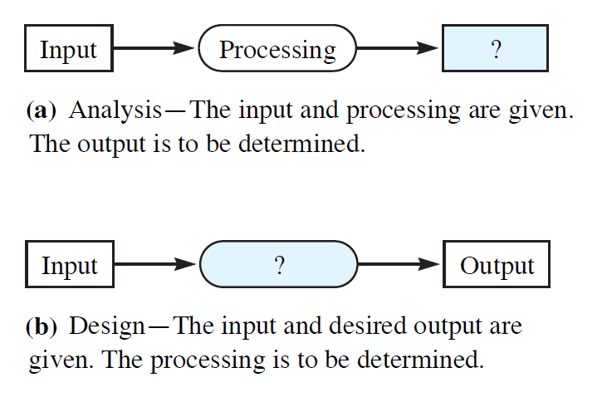
SOFTWARE ENGINEERING
Formalized process of analysis and Design of computer software systems
Notes:
Software Engineering is the design and analysis of computer software.
For Analysis, the Input and Processing are known and the output is the unknown that must be determined.
For Design, the Input and Output are known and the Processing must be determined.

Slide 27
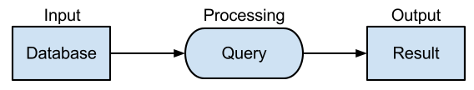
DATABASE SYSTEMS
DBMS - database management system
  Most common application at Level App7
  Stores data in records in a table format
  Programs allow users to add, delete & modify records
  SQL (Structured Query Language) Queries create output from data
Notes:
Databases are the most common application at Level 7. This may seem surprising until you realize that YouTube & Facebook are giant databases. Your bank account is in a database. All companies maintain their accounting, material requirements, customers and much more in a database. This list can go on and on.
A data base stores data in records usually in a table format. There are programs that allow users to add, delete, and modify records in the database.
SQL –Structured Query Language has become the industry standard for writing queries to create output from data in the tables. SQL like other programming languages has reserved words such as select, join, & where that are used to write queries.

Slide 28
ABSTRACTION OF COURSE OUTLINE
Chapter 1
Chapter 2
Chapter 5,
Chapter 6,
Chapter 7
Chapter 8,
Chapter 9
Chapter 3,
Chapter 4
Chapter 12
Chapter 10,
Chapter 11
Notes:
This class is organized as shown in this slide so we will plunge down into the lower levels and leave the familiar Level 7 behind.
Hang on for the ride!

